Slide 1
Weekly Update
Jorian Bruslind
Week 3

Slide 2
HyperRail Project
Current Status
Working with project stakeholders to integrate into site
NWREC (North Willamette Research and Extension Center)
On-campus greenhouses
Making improvements to controlling circuits
New integrated drivers
Better main controlling board
Slight improvements to mounting hardware
PETG upgrades for rain / UV resistance

Slide 3
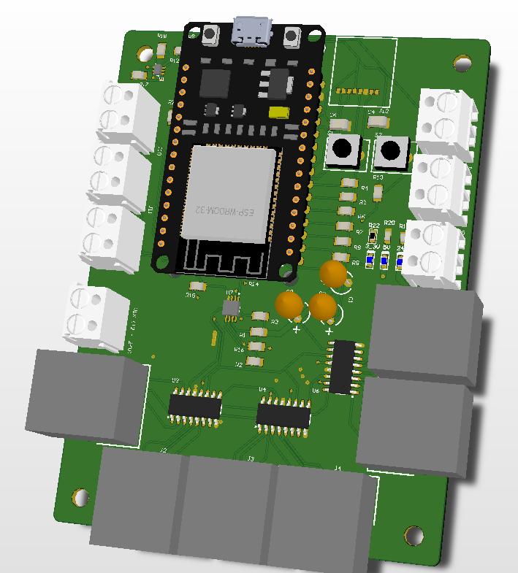
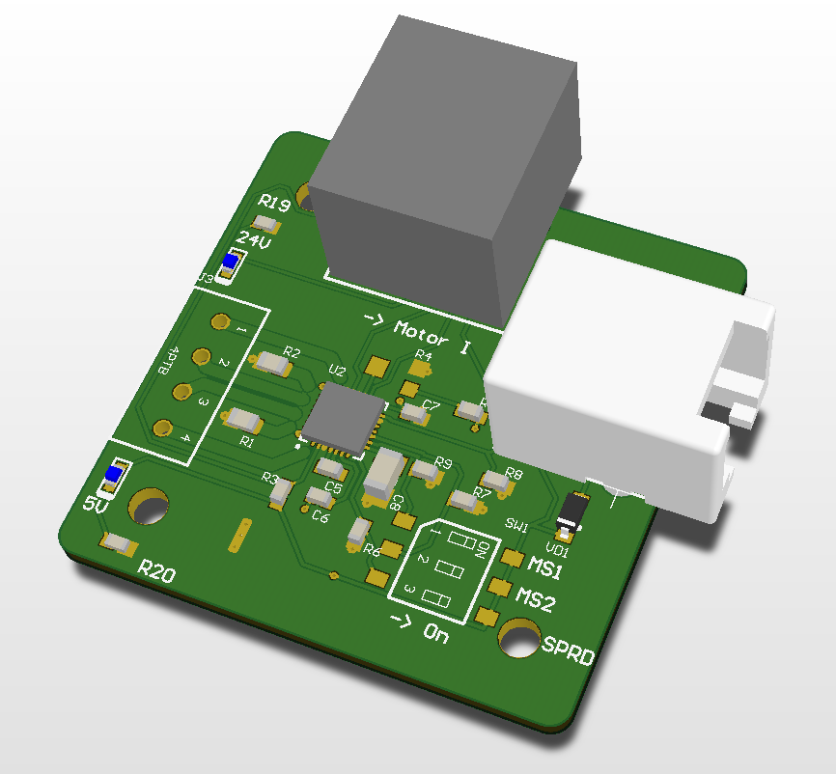
Current Status

Slide 4
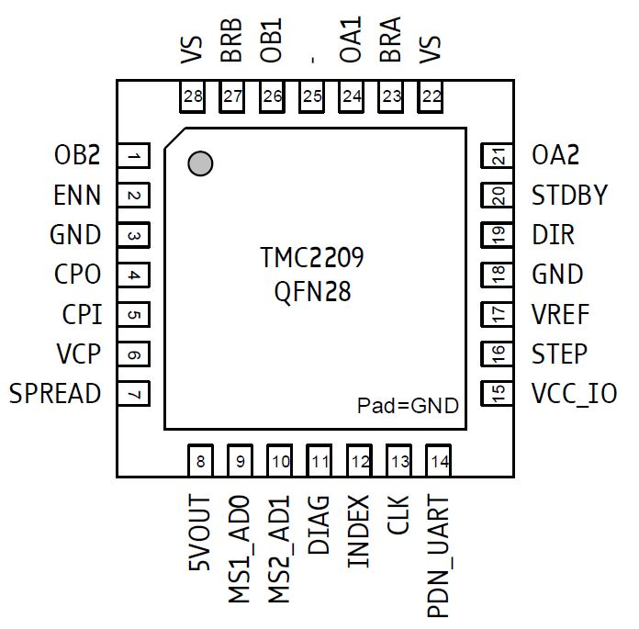
Project Work
Integrated Stepper Driver
TMC2209 breakout board for stepper motor controller
Modular connection points (POE+)
On-board voltage conversion
Customizable (current and driver mode)
ESP 32 GRBL
Built-in wifi control
Serial communication through USB with Gcode
Optional SD expansion
Up to 6 axis control (independent)

Slide 5
My Plan
Order enough components for full prototype
Assemble 4x stepper drivers, 1x ESP32 GRBL
Test design and check for any problems
Coordinated control
Automated control over USB / Wifi
Torque limit tests
Submit program of study

